Slide 1
Data Engineering
Data Engineering Learning Path
Srivatsan Srinivasan

Slide 2
Agenda
What is Data Engineering?
Quick Introduction to Data Engineering process
Data Engineering Tech Stack
Learning Path for Data Engineering
Live Q&A

Slide 3
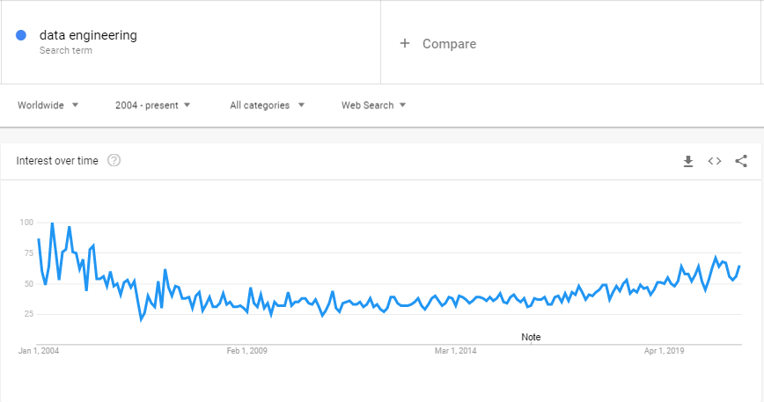
Data Engineering is not something new

Slide 4
What is Data Engineering?
Data Engineering is process of designing and building scalable and reliable data pipelines that collects, Ingests, governs, transforms,transports and structures data with the purpose of making it easily accessible and usable to data applications

Slide 5
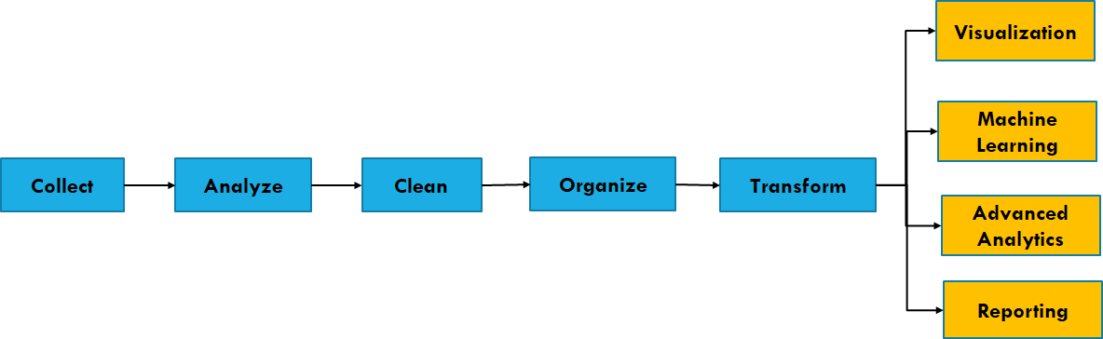




Data Pipelines

Slide 6
Data Pipelines
ELT vs ETL
Batch vs Stream processing
Data Warehouse vs Data Lake
Data platform in, On premise vs on Cloud

Slide 7
Data Pipelines
ELT vs ETL
Batch vs Stream processing
Data Warehouse vs Data Lake
Data platform in, On premise vs on Cloud
Data and Metadata Management
Data Security

Slide 8
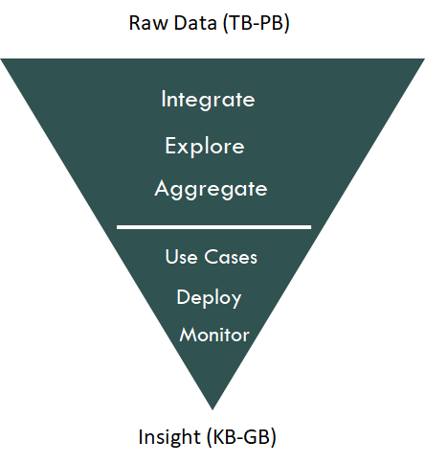
Data Lifecycle

Slide 9
Data Engineers are responsible for
Building Data Platforms
Define Data Architecture and Data Modeling
Handle data in various formats
Create ETL or ELT pipelines as well streaming data pipelines
Schedule and Deploy pipelines
Build frameworks or code for data management activities
Make data accessible with right governance in place
Enable Self service access to data

Slide 10
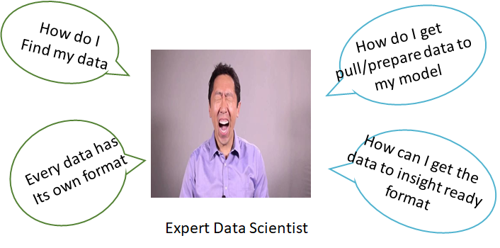
World without right data strategy or engineering

Slide 11






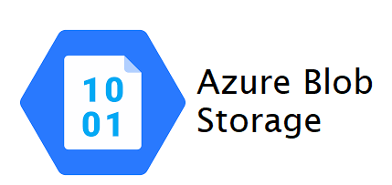

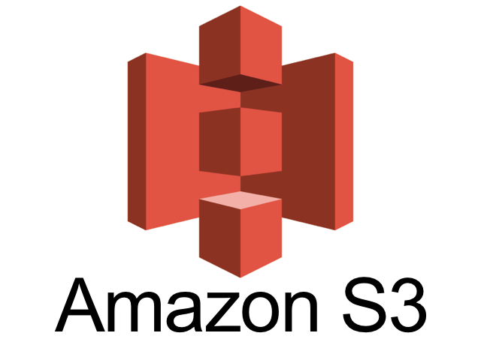

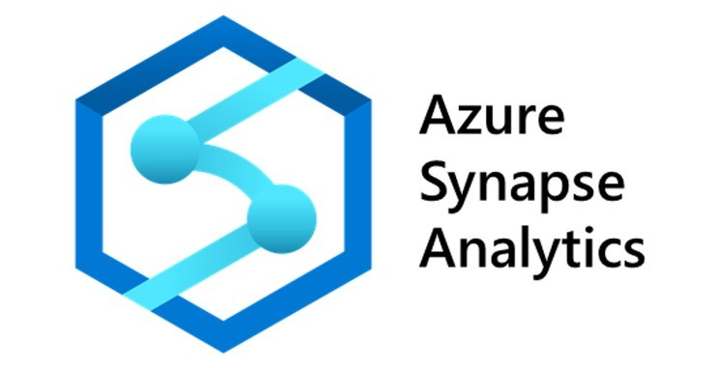




Data Engineering Tech Stack (Few Selected)

Slide 12
Learning Path - Level 1 - Foundation
Programming Language (Python or Scala preferably)
SQL
Data Warehousing Concepts
Understand Distributed Computing (Some history of Hadoop and MapReduce)
When to use Data Lake vs Data Warehouse vs RDBMS vs NoSQL
Master Apache Spark
Understand and pick one database from NoSQL and RDBMS

Slide 13
Learning Path - Level 2 - Advanced
Understand various Data Architectures (Real Time, batch, Event Driven etc)
Learn one streaming platform and stream processing engine
Pick one cloud provider and master their native data engineering product
Focus on cloud data warehouses, cloud big data services and managed spark services
Create and deploy pipelines on cloud with cloud based CI/CD

Slide 14
Learning Path - Level 3 - Expert
Deep dive into data architectures and data modeling (NoSQL, DWH etc)
Understand and build Cloud Native data architectures and sandboxes (Containers and K8s)
Hybrid Cloud
Focus on Data Management and Data Security Architecture
Build platforms that can democratize data and accelerate analysis

Slide 15
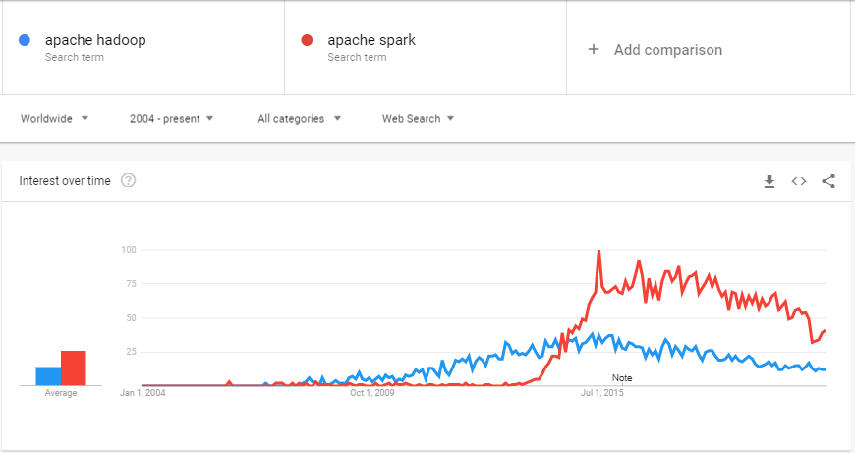
Hadoop and Spark Trends

Slide 16
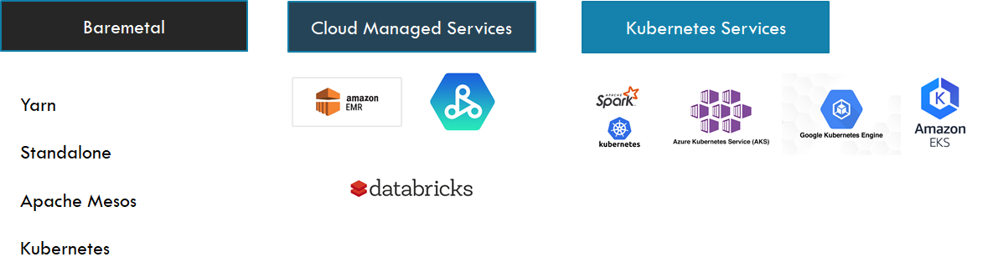
Why Spark?

Slide 17
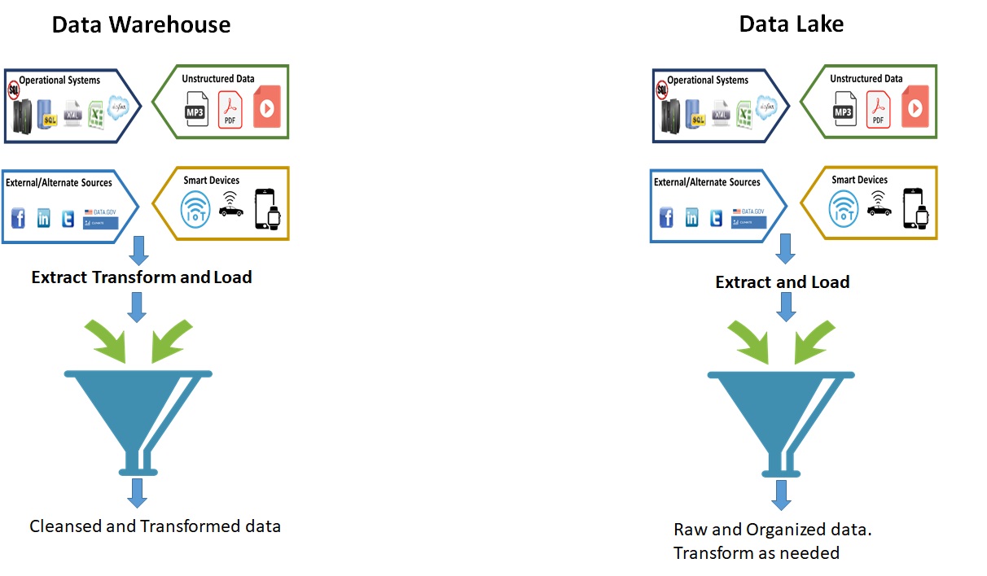
ETL vs ELT

Slide 18
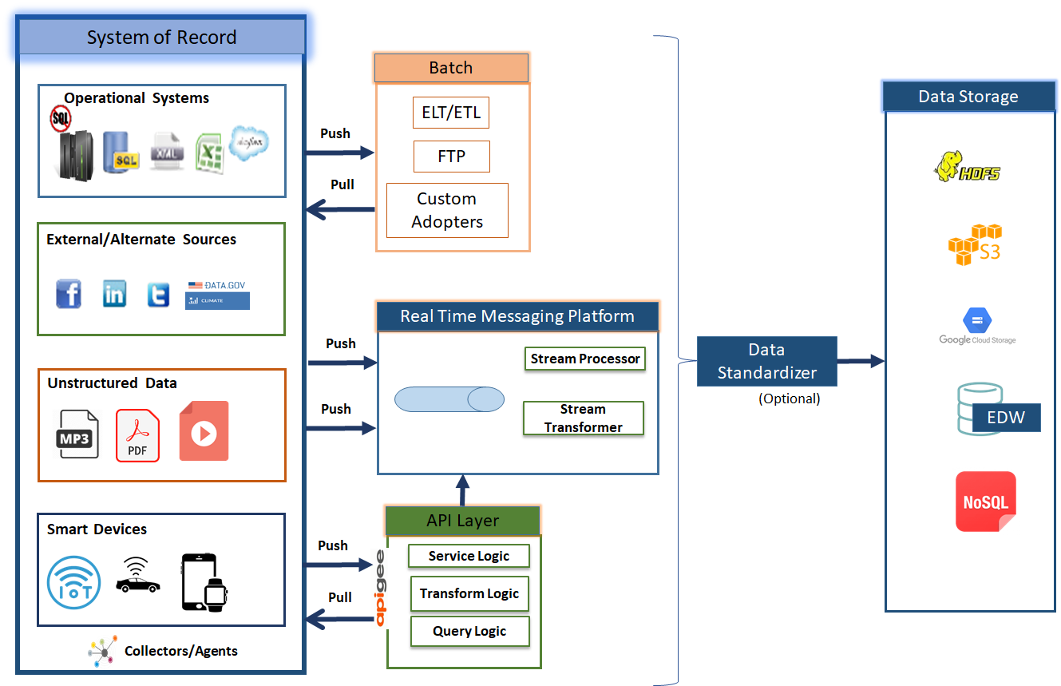

Slide 19
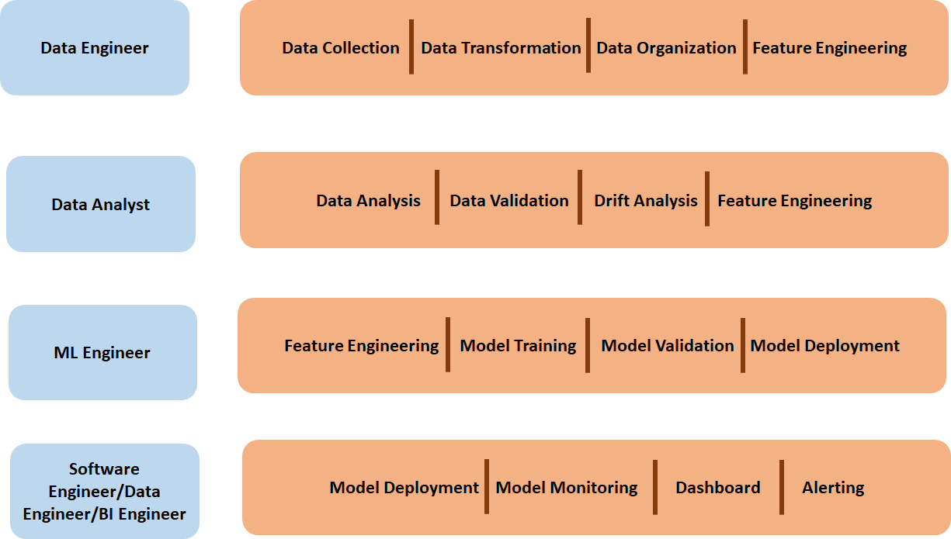
Role - Activity

